Slide 1

SUPERVISED AND UNSUPERVISED MACHINE LEARNING ALGORITHMS FOR CREDIT CARD FRADULENT TRANSACTION DETECTION
VEMU INSTITUTE OF TECHNOLOGY
Chittoor-Tirupati National Highway, P.Kothakota, Chittoor (Dt.), AP - 517112
Present By
Ms. G JYOTHIKA (194M1A0530)
Ms. A.S SRIDEVI (194M1A0505)
Ms. D. LIKHITHA (194M1A0523)
Ms. VIDYA.K (194M1A0551)
Under the Guidance of
Dr. C. SIVA BALAJI YADAV, Ph.D
Associate professor, Dept of CSE
Department of Computer Science & Engineering
2019-2023

Slide 2
CONTENTS
1. Objectives
2. Literature Survey
3. System Analysis
3.1 Existing System
3.2 Proposed System
3.3 Software and Hardware Requirements
4. System Design
4.1 System Architecture
4.2 Data Flow Diagram
4.3UML Diagrams
5. System Implementation
5.1 Modules
6. Screen Shots
7. Future Work
8. Conclusion
9. References

Slide 3
OBJECTIVES
Frauds in credit card transactions are common today as most of us are using the credit card payment methods more frequently. This is due to the advancement of Technology and increase in online transaction resulting in frauds causing huge financial loss.
In addition, fraudsters find ways to steal the credit card information of the user by sending fake SMS and calls, also through masquerading attack, phishing attack and so on.
This project aims in using the supervised and unsupervised algorithms of Machine learning such as Isolation Forest (IF), support vector machine (SVM) and Gradient Boosting (GB) in predicting the occurrence of the fraud.
Further, we conduct a differentiation of the accomplished supervised machine learning and unsupervised learning techniques to differentiate between fraud and non-fraud transactions.

Slide 4
LITERATURE SURVEY
S.NO1 | TITLE | AUTHOR | YEAR | DESCRIPTION
1. | Neural data mining for credit card fraud detection. | R. Brause, et.al | 1999 | Since only one financial transaction in a thousand is invalid no prediction success less than 99.9% is acceptable. This paper shows how advanced data mining techniques and a neural network algorithm can be combined successfully.
2. | Resilient identity crime detection. | V.C.S Lee, et.al | 2010 | The existing non-data mining detection system of business rules and scorecards, and known fraud matching have limitations. To address these limitations and combat identity crime in real time.

Slide 5
LITERATURE SURVEY
3. | Behavior Based Credit Card Fraud Detection Using Support Vector Machines. | V.Dheepa, et.al | 2012 | In this paper, behavior based classification approach using Support Vector Machines are employed and efficient feature extraction method also adopted.Generally credit card fraud detection problem suffers from a large amount of data, which is rectified by the proposed method.
4. | A New Framework for Credit Card Transactions Involving Mutual Authentication between Cardholder and Merchant | Shalini gupta, et.al | 2019 | In this paper, we discuss and analyze the current developments in online authentication procedures including biometrics, one-time-password systems and use of mobile devices and Public Switched Telephone Network for cardholder authentication.

Slide 6
EXISTING SYSTEM
A physical card is not required in the scenario of online shopping and only the information of the card is enough for a transaction. Therefore, it is much easier for a fraudster to commit a fraud.
The volume of electronic transactions has risen significantly in recent years due to the popularization of online shopping (e.g., Amazon, eBay).
Various supervised, learning methods like neural networks, decision trees, logistic regression, and support vector machines are often used to obtain the fraud patterns.
Fraud Detecting Software are existing, but they become unstable and require a lot of data to be processed.
There are ways in which the existing system built over supervised learning can be trained in wrong ways.
KNN’s speed was low with a medium accuracy and scored one of the lower scores. As for the cost all models built were expansive.
Logistic regression performed poorly as the accuracy.

Slide 7
DISADVANTAGES
Loss track of transaction.
Unsuitable data or transaction.
Difficult to recover from the problem.
Low Accuracy.
In efficient performance due to low dimensional data.

Slide 8
PROPOSED SYSTEM
Logical graph of behaviour Profiles which is a total order-based model to represent the logical relation attributes of transaction records.
The two methods are called phase Modulation (PM). Transactions labeled as fraudulent. True negative (TN)is the total number of legal transactions labeled as legal. False negative (FN) is the total number of fraud transactions which are not detected.
Detection of the fraudulent transactions will be made by using supervised and unsupervised machine learning techniques IForest, SVM and Gradient Boost those models will be used on a credit card transaction dataset.
Outlier detection the computation and memory required for the credit card fraud detection is much less in addition to its working faster and better in online large datasets. But their work and results showed that IForest was more accurate and efficient.

Slide 9
ADVANTAGES
More efficient result for detecting Fraud Detection discovery.
High accuracy.
Less detection time.
Get user-based historical records.
Avoid complex problems.

Slide 10
HARDWARE AND SOFTWARE REQUIREMENTS
Hardware requirements:
➢ System : Pentium dual core
➢ Hard disk : 120 GB
➢ RAM : 4 GB
Software requirements:
➢Operating system : Windows
➢ Programming Language : Python
➢ Tool : Anaconda
➢ Database : TensorFlow, Keras

Slide 11
SYSTEM ARCHITECTURE

Slide 12
DATA FLOW DIAGRAMS
Data Flow Diagram Level 0 For Credit Card Fraud Detection
Data Flow Diagram Level 1 For Credit Card Fraud Detection

Slide 13
DATA FLOW DIAGRAMS
Data Flow Diagram Level 2 For Prediction of fraud

Slide 14
UML DIAGRAMS
USE CASE DIAGRAM

Slide 15
UML DIAGRAMS
ACTIVITY DIAGRAM

Slide 16
UML DIAGRAMS
SEQUENCE DIAGRAM

Slide 17
UML DIAGRAMS
COLLABORATION DIAGRAM

Slide 18
MODULES
Data Collection
The outer overall functionality of the proposed system application this indicates that have collected the credit card dataset from various source and analysis and processing of data have done by predicting the farmland and classifying the rate of accuracy from this information by plotting the graph credit card fraud is predicted.
Pre-Processing
The data is cleaned before loading to the Classifier. Import the Label Encoder class from the sclera library, fit and transform the first column of the data, and then replace the existing text data with the new encoded data.
Feature Extraction
The Feature extraction by Layering of data. For feature extraction, first select the data and process data for original feature. Then reduce the feature by transform refining data. This can be done by selecting the data by CSV file and process the data for original feature and it was transformed and refining data to reduced feature, finally it predicts the accuracy.

Slide 19
MODULES
Splitting Data
The Splitting data by two ways are Training dataset and Testing dataset. In statistics and machine learning we usually split our data into two subsets: training data and testing data, and fit our model on the train data, in order to make predictions on the test data.
Classification
Classification of data through IForest (Isolation Forest) Algorithm use randomness by design to ensure they effectively learn the function being approximated for the problem. Randomness is used because this class of machine learning algorithm performs better with it than without.
Accuracy Prediction
The accuracy agriculture prediction occurs using the classifier, list with predicted values and plot the farmland graph. Predicting the test set result. The prediction result will give you probability of finding the farmland. This will convert that probability into binary 0 and 1. 1 for Fraud and 0 for Non-Fraud. This is the final step where this work evaluating our model performance.

Slide 20
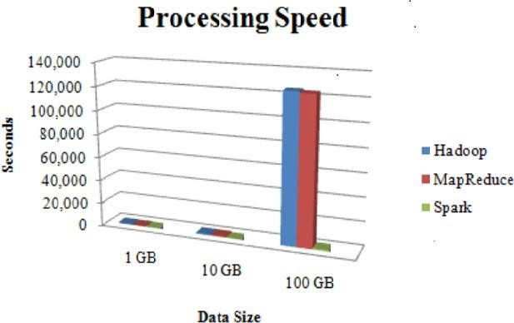
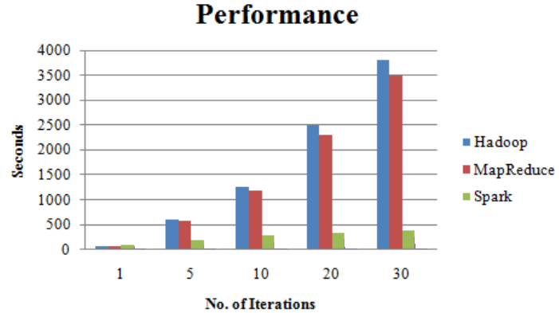
PERFORMANCE ANALYSIS
PROCESSING SPEED
This section extends the analysis of the techniques proposed previously for the big data forensic investigation. There are different factors that can influence the selection and performance of the forensic techniques. These factors should be analysed closely before carrying out the implementation. The following table has been populated based on the available resources and the sensitivity of the data to be used for investigation.

Slide 21
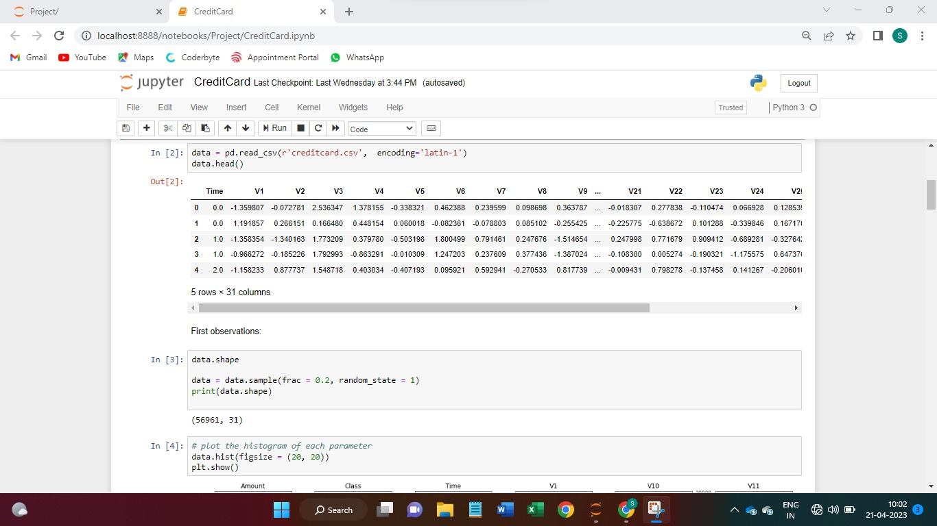
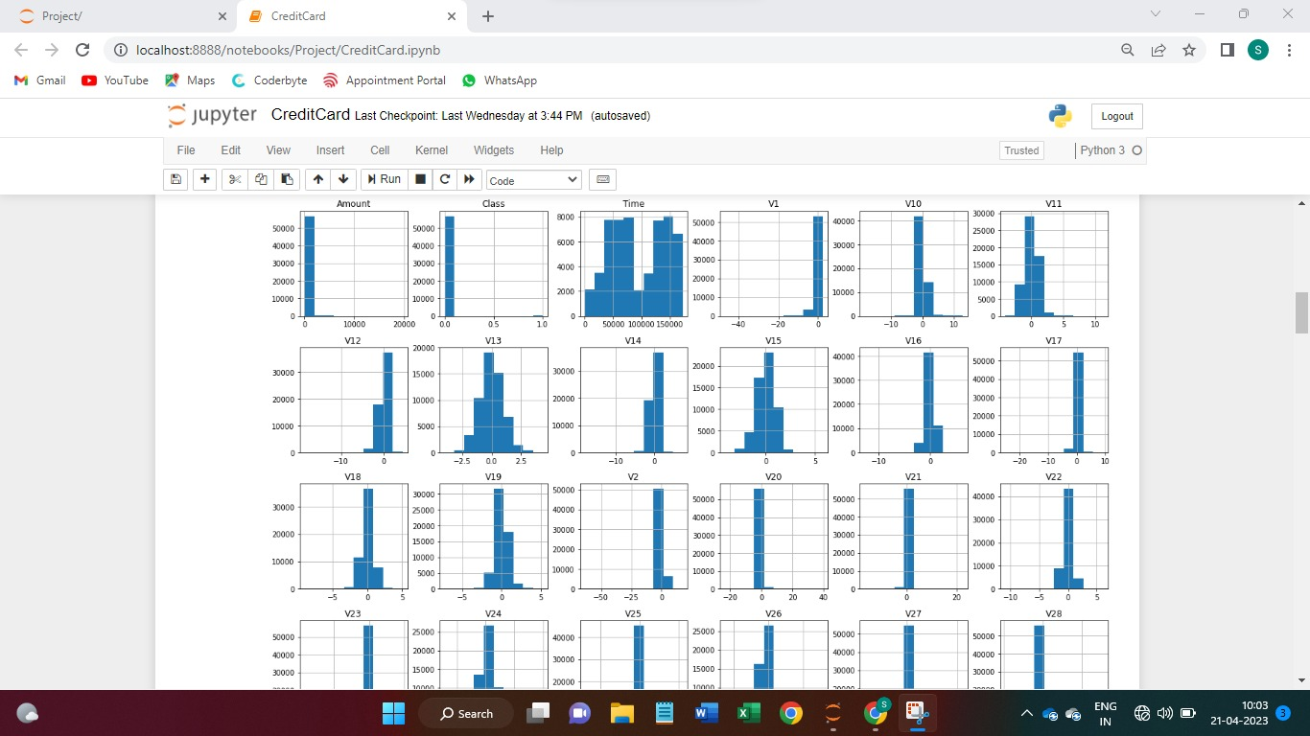
SCREENSHOTS

Slide 22
SCREENSHOTS

Slide 23
SCREENSHOTS

Slide 24
FUTURE WORK
We can furthermore implement new algorithms to our Indian credit-card holders transaction dataset and combine the results for these algorithms for precision and confusion matrix to get more legitimate values.
The outliers can be minimized in the present data set as they confuse the model while training it.
The correlation and variance are also less in the dataset which can be improved by minimizing the skewness of the data.
These improvements require the knowledge and support of experts from different sectors like machine learning and artificial intelligence experts, data scientists and bankers who will help us to provide a better form of data.

Slide 25
CONCLUSION
The model that we built helps the authorities to get notified of the fraud in credit-cards and take the further necessary steps over the transaction and label the transaction as fraud or legitimate transaction.
We used supervised and unsupervised algorithms like IForest, SVM and GB to select the features from our transaction dataset which uses correlation and variance as parameters to select the features.
The scores of each model were 99.77%, 99.08%, 99.71% for the Iforest, support vector machine and gradient boosting classifier algorithms respectively. These models have high accuracy and get the best results with high precision in determining the fraud detections in credit card transaction records.

Slide 26
REFERENCES
[1]. Li Yingjiu and Xinwen Zhang, "A security-enhanced one-time payment scheme for credit cards", in Proc. of 14th International Workshop on Research Issues on Data Engineering: Web Services for e-Commerce and e-Government Applications, 2004, Page(s): 40 - 47.
[2] W. Stallings, Cryptography, and network security: principles and practices, 3rd edition.
[3] Leila Seyedhossein, mahmoudrezahashemi “Mining Information from Credit Card Time Series for Timelier Fraud Detection”. IEEE-5th International Symposium on Telecommunications. (2010).
[4] E.W.T. Ngai, Yong Hu, Y.H. Wong, Yijun Chen, Xin Sun “The application of data mining techniques in financial fraud detection: A classification framework and an academic review of literature”. Elsevier-Decision Support Systems (2011). 50; (559–569).

Slide 27
THANK YOU

